Slide 1

Cloud computing for science A research-ScIT-ICT collaboration
Simone Baffelli

Slide 2
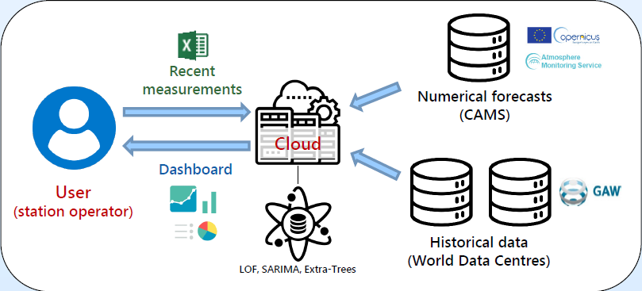




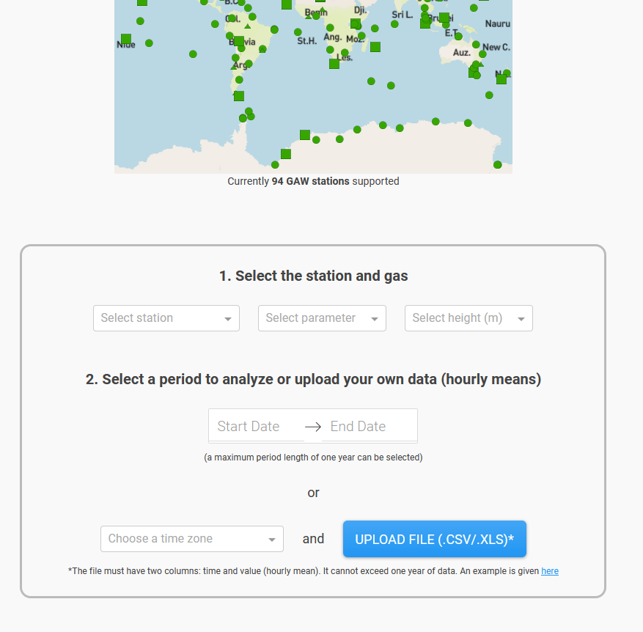



«Abstract»
Deployment
Scientific IT Team
Support request
Helpdesk
Review and support
Researcher: domain expertise

Slide 3

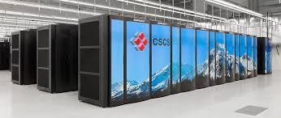


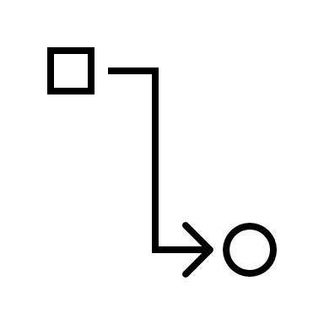
Cloud deployment for research
Reasons for cloud deployments
Not
Speed of deployment
HPC
Cost saving (scalability)
Sensitive data
Ease of deployment

Slide 4
Deployment procerss
Deployment
Scientific IT Team
Support request
Helpdesk
Review and support
Researcher: domain expertise

Slide 5
What should be on the cloud
For the moment, only workloads that:
Process data classified as "public" or "internal"
Low computational demand
Storage
Availability

Slide 6
Basis for the discussion
Computation load: heavy ($$$), medium ($$), low($)
Data confidentiality: open, internal, confidential, strictly confidential [1]
Service availability: permanently accessible (99.9% - 99.999%) ($$$-4*$), available on request ($$), available on request with delay ($).
Data availability: normal ($), high ($$)
Data size:
Data Integrity: normal ($), high ($$)
Access to internal services: yes, no
Users: Researchers
[1]Lenkung Dokumente und Daten (empa.ch)

Slide 7
Our focus
Computation load: heavy ($$$), medium ($$), low($)
Data confidentiality: open, internal, confidential, strictly confidential [1]
Service availability: permanently accessible ($$$), available on request ($$), available on request with delay ($).
Data availability: normal ($), high ($$)
Data Integrity: normal ($), high ($$)
Access to internal services: yes, no
Iser
[1]Lenkung Dokumente und Daten (empa.ch)

Slide 8
Our role
Workload?
Heavy
HPC
Low, Medium
Cloud
On-Prem
Data
Public, Internal
On-Prem
Cloud
Confidential, Strictly confidential
On-Prem
HPC
User comes with use case
We help classify
Based on classification, decision:
Cloud
On-Prem
CSCS
….
For low-risk, we proceed with deployment
For other cases, PA and review from CISO

Slide 9

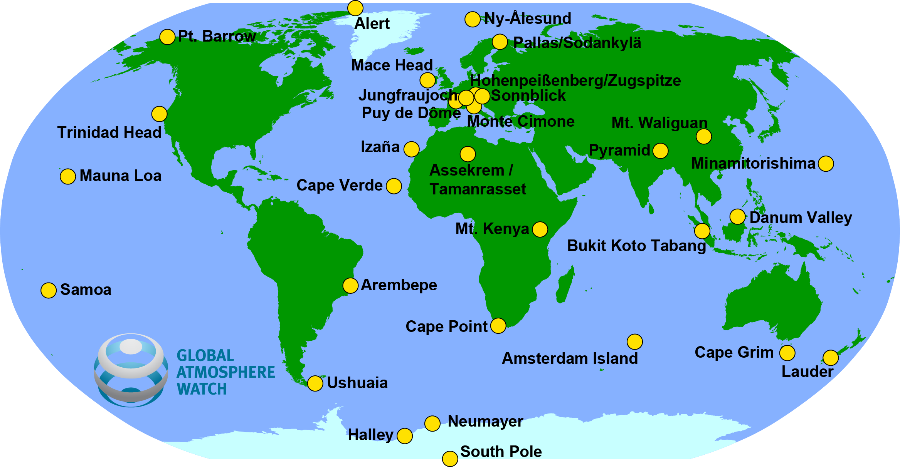
Example: Global Atmosphere Watch
Global Atmospheric Watch
100s stations worldwide
Empa
Runs QA center (Empa - Air Pollution / Environmental Technology - QA/SAC Switzerland)
Developed model for near-real time quality control

Slide 10
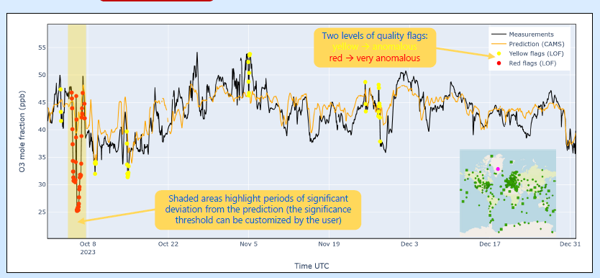
Quality control
Anomalies are detected with:
LOF (local outlier factor)
ML-model based comparison with CAMS forecast
Source: Y. Brugnara, M. Steinbacher, L. Emmenegger

Slide 11
Goals
Functional requirements:
The application allow users to run quality control on partial measurement series
The results shall be displayed graphically
The application shall be publicly accessible over the internet
Quality (non-functional) requirements:
The application should not require any installation
The application shall be extensible with new stations
The application shall be upgradeable with new data
The application should be deployed automatically after a new commit

Slide 12
Classificaiton
This project is ideal as a showcase:
Low workload
Public data
Normal availability
Normal integrity
10 GB of data
No authentication for users
No connection to internal systems
Decision:
We can deploy on our own

Slide 13
Deployment pricing
There are two models for deployment:
On-prem with a Docker host
On the cloud
Assumptions:
4 vCPUs
16 GB RAM
5 days / month uptime

Slide 14
Solution strategy
The application uses ML methods (Random forests and statistical=
The application is developed using dash
All reference data is stored using sqllite
The application is deployed using Docker containers on a cloud platform
Perfect use case for a Scientific IT – ICT collaboration on workloads for research

Slide 15

Context and component
Scope and context
ML model
Level 1
Dasboard
Historical data (SQLITE)

Slide 16
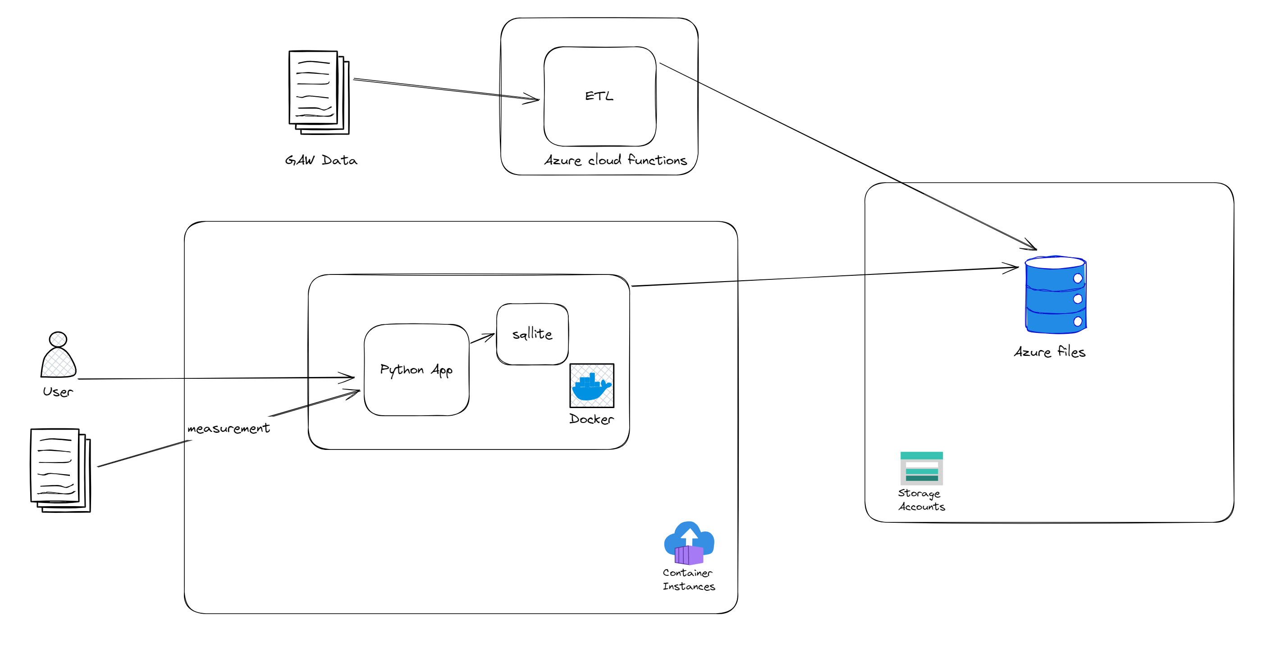
Cloud architecture

Slide 17
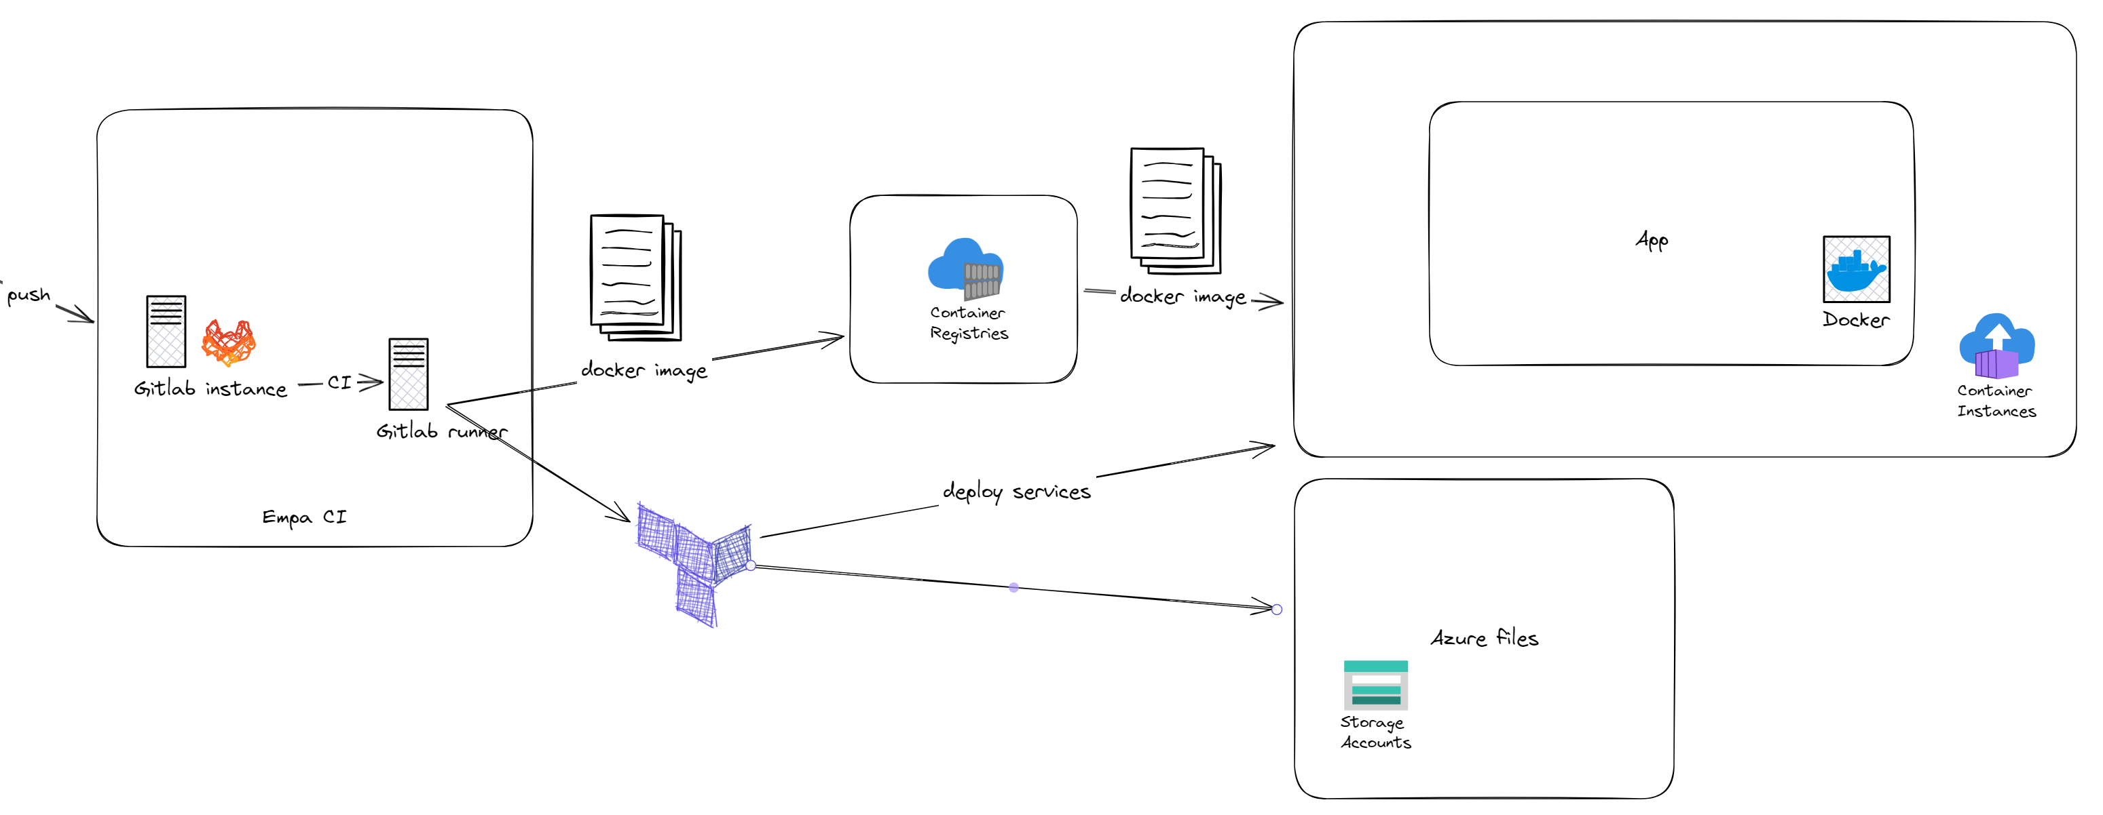
Deployment architecture
Build container on Empa CI
Push to Azure Container Registry
Deploy using Terraform from Empa CI

Slide 18
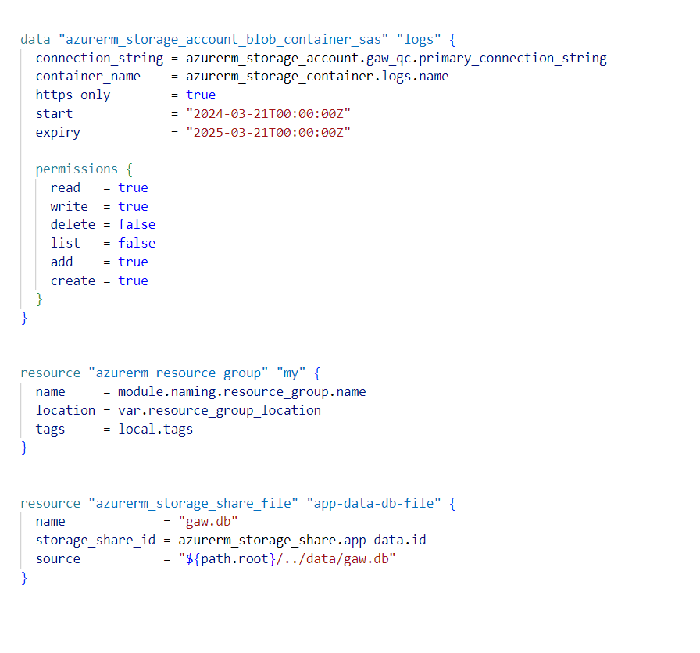
Deployment automation: TF
Cloud service configuration automated with TF
Declarative
We define the state of services we want

Slide 19
Deployment pricing
On cloud:
Azure container instances (https://azure.com/e/53293edcd8c14ad18af53e101d7abb64) : 35 $ / Month
Azure container apps (https://azure.com/e/f3dae189b49841acabc21b62a734e643): 148 $ /months
Plus 3-4 PD for engineering
Locally:
7 PD of engineering and project management
Depends on the availability of VM platform etx.

